Slide 1
How to measure if e-commerce operation is healthy?
Website: https://github.com/qiqi-luo/Order-Report.git
Author: Qiqi Luo
Date: 2020/8/25

Slide 2
Introduction
The Goal
The report is to oversee if operation is healthy in April by comparing key indicators in Mar and Apr
Time Period
From 2016/3/1 to 2016/5/1. 461804 Records.
Data_Mar: 2016/3/1 – 2016/3/30 (to compare with April, 3/31 excluded)
Data_Apr: 2016/4/1 – 2016/4/30
The data sample:
Field Description:
order_id | user_id | amount | paytime | day
539420 | 11211 | 657.0 | 2016/5/1 | 1
539421 | 11211 | 472.0 | 2016/4/30 | 30
539422 | 101208 | 767.0 | 2016/5/1 | 1
539423 | 11211 | 1036.0 | 2016/5/1 | 1
539425 | 11211 | 801.0 | 2016/4/30 | 30
order_id: unique ID for orders
user_id: unique ID for clients
amount: price of each order
paytime: payment date of each order
day: the day of the month

Slide 3
Table of Contents
Overall Trend Analysis
Three index -- Revenue, Orders, Revenue per order
User Behavior Analysis
Three index – Active Users, Avg revenue / user (consumption level), Avg orders / user (frequency)
Did 20% users contribute 80% revenue?
Relationship between consumption amount and frequency
User Label Analysis
New users and churned users per day
User Group
RFM Model and ‘New, active, inactive, churn, return’ model
User life cycle -- by days user remained
Repurchase Rate and Purchase Back Rate

Slide 4
Overall Trend

Slide 5
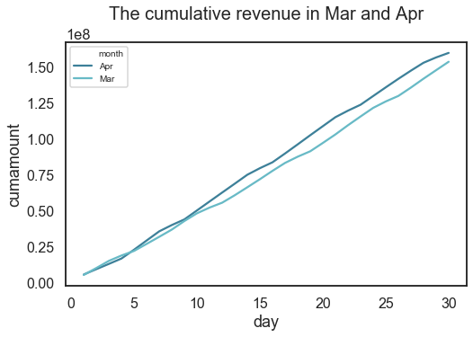
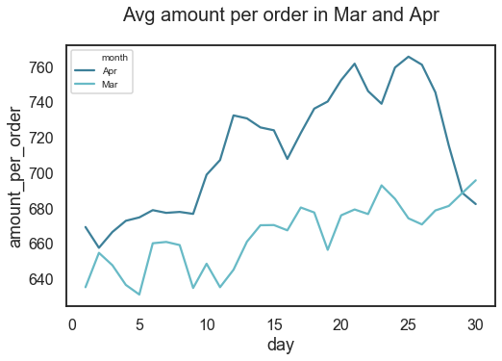
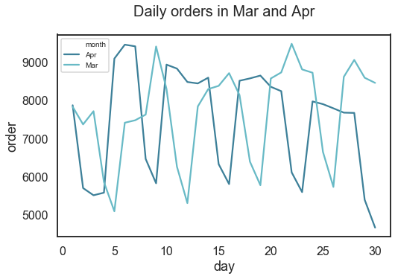
Overall Trend -- Revenue = Price * Orders
Cumulative Revenue in Apr is beyond Mar
Average Price increases by 48 in Apr
Revenue:
Mar:153.45 M Apr: 159.63 M
An effort to increase price since around 3/15, and the trend continued in April.
Accordingly, 240 less orders were made every day on average. And the trend is still going down.
But overall, the revenue increased by 6M in Apr.
Orders declined in Apr and tend to continue

Slide 6
User Behavior

Slide 7
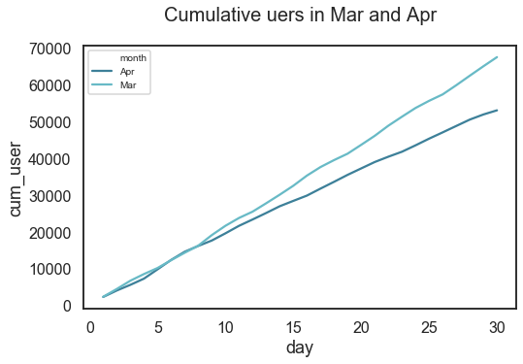
User Behavior – Active User, consumption level and frequency
9K less users in Apr
The data is highly skewed and there are super high value users who contributed over 70% revenue.
Most users consumed just once and 75% of them spent less than 1000.
 | amount_Mar | orders_Mar | amount_Apr | orders_Apr
count | 53394 | 53394 | 43967 | 43967
mean | 2874 | 4.3 | 3631 | 5.1
std | 463,759 | 655 | 573,054 | 772
min | 18 | 1 | -2 | 1
25% | 456 | 1 | 497 | 1
50% | 651 | 1 | 670 | 1
75% | 995 | 2 | 987 | 1
max | 107.16M | 151,362 | 120.16M | 161,973

Slide 8
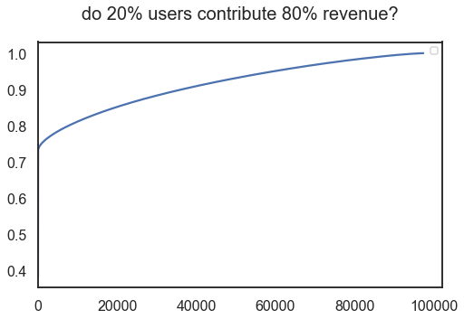
User Behavior – Did 20% users contribute 80% revenue
8.5% users contribute to 80% revenue
There is one super high value user (id=11211), who contributed over 70% revenue. And the average price for this user is 741 in Apr, 667 in Mar, which are not too high, so this user made huge amount of orders at a high-level price.
The list showed part of high value users..
user_id | amount | month | contribution
11211 | 1.201601e+08 | Apr | 0.383794
11211 | 1.071615e+08 | Mar | 0.726070
57282 | 2.338080e+05 | Mar | 0.726817
57282 | 2.191870e+05 | Apr | 0.727517
68226 | 1.624153e+05 | Mar | 0.728036
62590 | 1.344430e+05 | Apr | 0.728465
14427 | 1.152400e+05 | Mar | 0.728833
53616 | 1.072430e+05 | Mar | 0.729176
14427 | 1.023990e+05 | Apr | 0.729503
14271 | 9.679000e+04 | Mar | 0.729812

Slide 9
User Behavior – Consumption level and frequency of different groups
Super user contribute less revenue in Apr
Super high value users are users who spent over 150k
(user 11211 excluded)
Half of super high value users churned in Apr
Super high value users spent 16k less in Apr and made 35 less orders
The Avg price in Apr is 100 more than in Mar
 | Mar | Apr
Users: | 52 | 26
Avg amount: | 58192 | 41607
Avg orders: | 89.9 | 54.8
Avg price: | 647 | 759
Revenue: | 1.44M | 1.08M

Slide 10
User Behavior – Consumption level and frequency of different groups
High value user contribute less revenue in Apr
High value users are users who spent over 2k
(user 11211 excluded)
High value users spent 30 more in Apr and made 0.13 less orders
The price in Apr is 35 more than in Mar
 | Mar | Apr
Users: | 2492 | 2287
Avg amount: | 3206 | 3237
Avg orders: | 4.04 | 3.91
Avg price: | 793 | 827
Revenue: | 7.99M | 7.40M

Slide 11
User Behavior – Consumption level and frequency of different groups
Normal value user contribute less revenue in Apr
Normal value users are users who spent less than 2k
(user 11211 excluded)
Near 10k normal value users churned in Apr
Normal value users spent 10 more in Apr and made 0.1 less orders
The price in Apr is 57 more than in Mar
 | Mar | Apr
Users: | 50877 | 41653
Avg amount: | 724 | 743
Avg orders: | 1.31 | 1.22
Avg price: | 552 | 609
Revenue: | 36.87M | 30.98M

Slide 12
User Behavior – Increase price or not?
Increase price or not?
User 11211 reversed Apr’s revenue
Increase
Stop increasing
 | Mar | Apr
Super: | 1.44M | 1.08M
High: | 7.99M | 7.40M
Normal: | 36.87M | 30.98M
Subtotal: | 46.29M | 39.47M
Plus 11211: | 107.16M | 120.16M
Total: | 153.45M | 159.63M
Release the consumption potential of 11211
11211 is equal to 43966 *3 users in April
Increase price may lead to higher profit，keep loyal users only
11211 is an outlier
can not rely on one user too much
especially we need to stop increasing price for super user to recall them back
Risk management

Slide 13
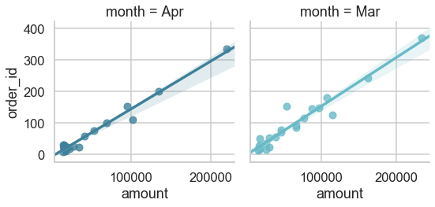
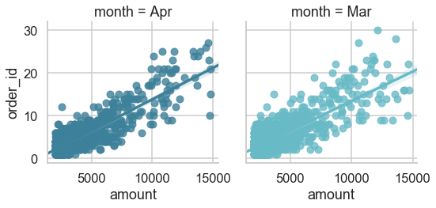
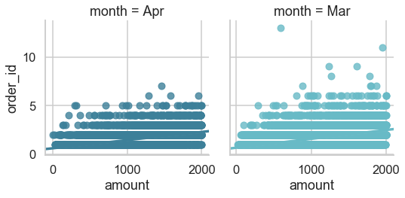
User Behavior – Relationship between amount and frequency
There is linear relationship between amount and frequency for users who spent over 2k.
For the majority normal users, they often made less than 5 orders at totally different price.
Super user’ price is stable
High value user’ price is stable
Normal value user’ price varies a lot

Slide 14
User Label

Slide 15
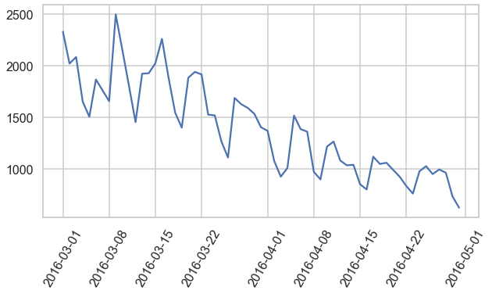
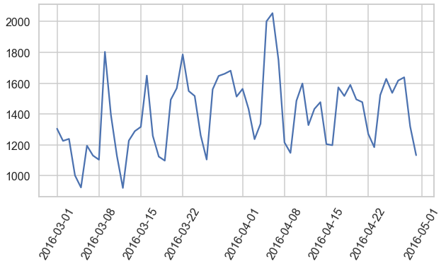
User Label – User acquisition and churn
Acquisition becomes hard when increase price.
Around between 1300 and 1400 users churn per day from March to April.
User acquisition shows declining trend
Churn rate is stable

Slide 16
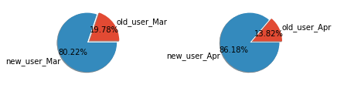
User Label – User acquisition and churn
Less users purchase more than once in April

Slide 17
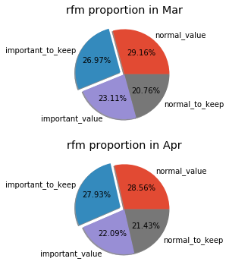
User Label – RFM structure
No big change in user structure in terms of RFM model
Important to keep:
Contribute larger revenue
Purchase frequently
Purchase recently
Important value:
Contribute larger revenue
Purchase frequently
No Purchase recently
User label
Normal to keep:
Contribute smaller rev.
Purchase frequently
Purchase recently
Normal value:
Contribute smaller rev.
Purchase frequently
No Purchase recently

Slide 18
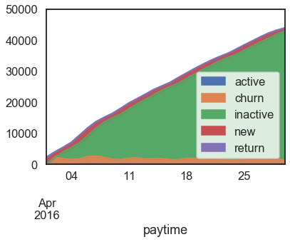
User Label – Life Cycle Period
Healthy structure
active return
New churn inactive

Slide 19
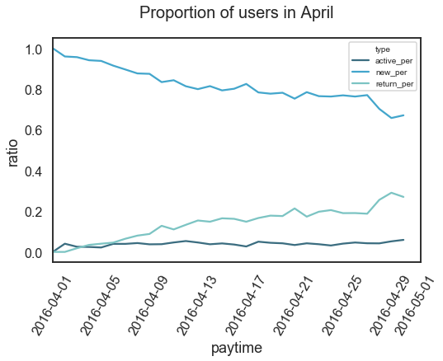
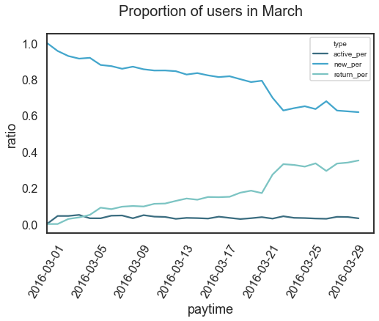
User Label – Life Cycle Period
People are more likely to return in Mar

Slide 20
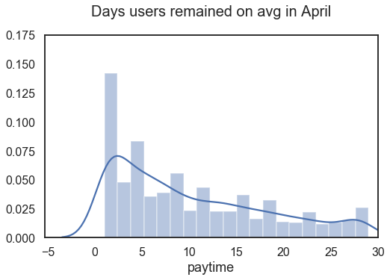
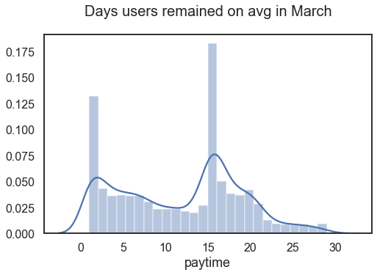
Life Cycle – How long users stay on avg?
For users who stay longer than 5, the remaining days distribute more evenly
After filtering users just purchase once

Slide 21
Repurchase and purchase back ratio

Slide 22
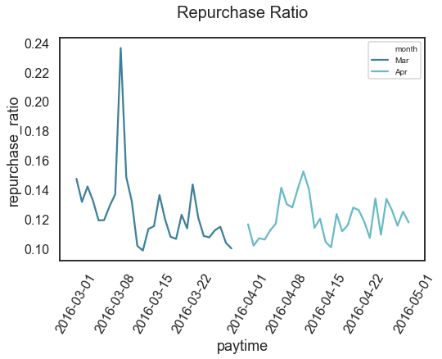
Repurchase Ratio – do users purchase more than once in a day?
Repurchase ratio in last half of Apr is less than in Mar
After calculation, 24% users in March purchase again in April.
And users in Mar tend to purchase more than once in a day.

